Slide 1
Going Further with REST Services

Slide 2
Contents
Setting the scene
Using HTTP POST to insert
Using HTTP PUT to update
Using HTTP DELETE to delete
Implementing REST clients
Exercise
Demo service project:
DemoRestServices

Slide 3
1. Setting the Scene
Overview
Example application
Testing the example application

Slide 4
Overview
All of the examples so far have shown how to GET data from a REST service
By annotating controller methods like this…
It's also possible (and extremely commonplace) to support the other HTTP verbs
By annotating controller methods like this…
@RequestMapping(method=RequestMethod.GET, value= … )
@RequestMapping(method=RequestMethod.POST, value= … ) // Insert
@RequestMapping(method=RequestMethod.PUT, value= … ) // Update
@RequestMapping(method=RequestMethod.DELETE, value= … ) // Delete

Slide 5
Example Application
Example project:
DemoRestServices
Domain class
CatalogItem
Service-layer
ItemService
ItemServiceImpl
REST controller
MyFullController

Slide 6
Testing the Example Application
To test the example, we'll use the Advanced Rest Client in the Chrome browser
You can install this easily in Chrome
Allows you to submit all kinds of requests to a URL
GET, PUT, POST, DELETE, etc.
Also allows you to set HTTP headers on your request
E.g. Content-Type=application/xml
E.g. Content-Type=application/json
E.g. Accept=application/xml
E.g. Accept=application/json

Slide 7
2. Using HTTP POST to Insert
Implementing HTTP POST in the service
Sending data as XML
Sending data as JSON

Slide 8
Implementing HTTP POST in the Service
Typical role of an HTTP POST handler method:
To insert a new item into a back-end data store
Here's how to do it:
Notes:
Client passes the new object (as JSON or XML)
Service returns the object after insertion (as JSON or XML) - why?
Service also returns a "CREATED" HTTP status
@RequestMapping(method=RequestMethod.POST,
value="/item",
headers={"Content-Type=application/json, application/xml",
"Accept=application/json, application/xml" })
@ResponseStatus(HttpStatus.CREATED)
public CatalogItem addItem(@RequestBody CatalogItem item) {
service.insert(item);
return item;
}
MyFullController.java

Slide 9
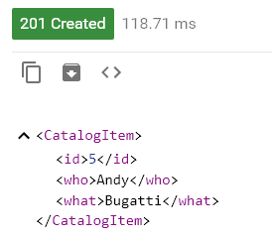
Sending Data as XML
In the Advanced Rest Client, POST XML data as follows…
Request URL:
http://localhost:8081/itemManager/item
Headers:
Content-Type: application/xml
Accept: application/xml
Body:
Response
<CatalogItem>
<what>Bugatti</what>
<who>Andy</who>
</CatalogItem>
Send

Slide 10
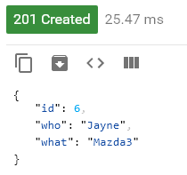
Sending Data as JSON
In the Advanced Rest Client, POST JSON data as follows…
Request URL:
http://localhost:8081/itemManager/item
Headers:
Content-Type: application/json
Accept: application/json
Body:
Response
{"what":"Mazda3","who":"Jayne"}
Send

Slide 11
3. Using HTTP PUT to Update
Implementing HTTP PUT in the service
Sending data as XML
Sending data as JSON

Slide 12
Implementing HTTP PUT in the Service
Typical role of an HTTP PUT handler method:
To update an existing item in a back-end data store
Here's how to do it:
Notes:
The URL includes the item id as a path variable (standard REST)
The HTTP message body in the response is empty
@RequestMapping(method=RequestMethod.PUT,
value="/item/{id}",
headers={"Content-Type=application/json, application/xml",
"Accept=*/*" })
public @ResponseBody void modifyItem(@PathVariable int id,
@RequestBody CatalogItem item) {
System.out.println("Modifying item to " + item);
service.update(item);
}
MyFullController.java

Slide 13

Sending Data as XML
In the Advanced Rest Client, PUT XML data as follows…
Request URL:
http://localhost:8081/itemManager/item/1
Headers:
Content-Type: application/xml
Body:
Response
<CatalogItem>
<id>1</id>
<what>Tesla</what>
<who>Andy</who>
</CatalogItem>
Send

Slide 14

Sending Data as JSON
In the Advanced Rest Client, PUT JSON data as follows…
Request URL:
http://localhost:8081/itemManager/item/1
Headers:
Content-Type: application/json
Body:
Response
{
"id":2,
"what":"Mini",
"who":"Jayne"
}
Send

Slide 15
4. Using HTTP DELETE to Delete
Implementing HTTP DELETE in the service
Sending an HTTP DELETE request

Slide 16
Implementing HTTP DELETE in the Service
Typical role of an HTTP DELETE handler method:
To delete an existing item in a back-end data store
Here's how to do it:
Notes:
The URL includes the item id as a path variable (standard REST)
The HTTP message body in the response is empty
@RequestMapping(method=RequestMethod.DELETE,
value="/item/{id}",
headers="Accept=*/*")
public @ResponseBody void deleteItem(@PathVariable int id) {
service.delete(id);
}
MyFullController.java

Slide 17

Sending an HTTP DELETE Request
In the Advanced Rest Client, DELETE an item as follows…
Request URL:
http://localhost:8081/itemManager/item/1
Headers:
(None)
Body:
(None)
Response
Send

Slide 18
5. Implementing REST Clients
Overview of Java clients
Using RestTemplate
RestTemplate methods
Example Java client
Implementing HTML clients
Demo client project:
DemoRestClients

Slide 19
Overview of Java Clients
So far we've seen how to implement a completely functional REST service
Supports GET, POST, PUT, and DELETE HTTP verbs
We've also seen how to test the service interactively
Using the Chrome Advanced Rest Client tool
Spring also allows you to invoke REST services from a fully fledged client
Enables you to submit HTTP requests as XML or as objects
Also allows you to retrieve response as XML or as objects

Slide 20
Using RestTemplate
The key ingredient in Spring's support for REST clients is the RestTemplate class
Spring Boot auto-configuration includes RestTemplate automatically
You can configure if necessary, via RestTemplateBuilder
RestTemplate follows the conventional approach in Spring integration APIs
Simplifies sending HTTP requests to REST service endpoints, and retrieving the responses

Slide 21
RestTemplate Methods
Here are some key methods in the RestTemplate class
Method
Description
getForObject(String, Class, Object...)
Performs an HTTP GET operation
postForObject(String, Object, Class, Object...)
Performs an HTTP POST operation
put(String, Object, Object...)
Performs an HTTP PUT operation
delete(String, Object...)
Performs an HTTP DELETE operation
exchange(String, HttpMethod, object, responseType)
Performs any HTTP operation, as specified

Slide 22
Example Java Client (1 of 2)
The DemoRestClients project invokes a REST service
public interface MyRestClient {
public void doRestCalls();
}
MyRestClient.java
@Component("MyRestClient")
public class MyRestClientImpl implements MyRestClient {
private String baseAddress = "http://localhost:8081/itemManager";
@Override
public void doRestCalls() {
// Code to call REST service via RestTemplate object - see next slide.
}
}
MyRestClientImpl.java

Slide 23
Example Java Client (2 of 2)
doRestCalls() performs the following tasks:
Create a RestTemplate object, for use throughout the method
Get a single item
Get a collection of items
Delete a single item
RestTemplate template = new RestTemplate();
CatalogItem item2 = template.getForObject(baseAddress + "/item/2", CatalogItem.class);
ParameterizedTypeReference<List<CatalogItem>> responseType =
new ParameterizedTypeReference<List<CatalogItem>>() {};
ResponseEntity<List<CatalogItem>> response = template.exchange(baseAddress + "/items",
HttpMethod.GET,
null,
responseType);
template.delete(baseAddress + "/item/2");

Slide 24
Implementing HTML Clients (1 of 2)
It's very easy to call REST services from an HTML web page – this is one of the reasons REST is so popular
Use JavaScript code to ping the appropriate REST URLs
Typical scenario:
Use Ajax to invoke REST services asynchronously
Use JSON as the data format in transit
Use a library such as jQuery to simplify your code
In the DemoRestClients project, see the static folder
index.html
scripts/jquery-1.11.3.min.js
styles/stylesheet.css

Slide 25
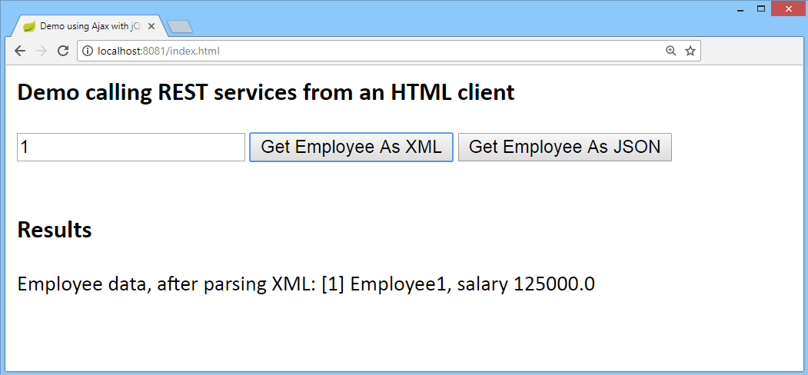
Implementing HTML Clients (1 of 2)
Run the DemoRestClients project
Then browse to http://localhost:8082/index.html
You can get an employee as XML or JSON

Slide 26
Any Questions?

Slide 27

Exercise
In your "Online Retailer" app, define a class named CatalogRestController, to support catalog management tasks:
Insert, update, and delete items in the catalog
Test your new features via a tool such as the Chrome Advanced REST client
If time permits:
Write code to consume the REST service operations programmatically, by using Spring's RestTemplate class
Solution:
SolutionRest2

